Slide 1



Analysis of L&T Vehicle Loan
Group -5
Pushyami Keerthi
Paridhi Holani
Parth Cholera

Slide 2
Table of contents
Data Preparation
Analysis & Modelling
Validation – examining the models (Performance on test sample)
Executive Summary
Analysis and Modelling – Evaluation of Models
Challenges
Appendix
Choose Model & Feature Selection
Business Goal
Introduction & Problem Statement
Analysis and Modelling – examining the models (Performance on Train sample)
Data Collection / Data Set
Flow Chart & Process Cycle
Analysis and Modelling – Scaled score
Scaled score – Summary (Proposed solution)

Slide 3
Executive Summary
During the last few years, financial sectors had lots of ups and down due to demonetization / MNC’s mergers etc leading to banks started review each and every minute details of clients / customer and companies.
Over the days Financial institutions incur significant losses, Major chuck was due to the default of vehicle loans. It has a strong correlation with the luxury people wants [buy a vehicle] vs there financial status vs EMI defaulting.
It has observed that people buy product’s on EMI’s and jumble up while paying EMI’s.
This has led to the tightening up of vehicle loan underwriting and increased vehicle loan rejection rates. The need for a better credit risk scoring model is also raised by these institutions to estimate the determinants of vehicle loan default.
On contrary due to this fear of loan losses company has taken measures of tightening up of vehicle loan underwriting and hence increase of loan rejection rates.
The company stakeholders have decided to approach for a better credit risk scoring model.

Slide 4
Introduction
Financial institutions incur significant losses due to the default of vehicle loans. This has led to the tightening up of vehicle loan underwriting and increased vehicle loan rejection rates. The need for a better credit risk scoring model is also raised by these institutions to estimate the determinants of vehicle loan default.
On contrary due to this fear of loan losses company has taken measures of tightening up of vehicle loan underwriting and hence increase of loan rejection rates.
The company stakeholders have decided to approach a for a better credit risk scoring model.
Problem
A part of developing credit risk framework for vehicle loan underwriting process, a financial institution wants to accurately predict the probability of loanee/borrower fail to repay the first installment of loan amount.

Slide 5
Business Goal
To build a predictive model that can be used by Banks to make better decisions based on there datasets.
Over the years we have seen that predictive analytics application allows the financial institution to identify the risks and address them in real time to get better outcomes.
Based on the model, bank will be able to analyze data related to the customer’s before making the decision of issuing Vehicle loan.
The model developed will use all possible factors and data to predict whether the customer would fail or succeed in making the first EMI with a rational accuracy. It would benefit the bank before they make any decisions against that customer’s & there policy.
The loan default prediction is a problem of binary classification (should the investor lend or not). And hence Logistic Regression is a good model for this problem.
Create predicative model to classify each borrower as defaulter or not using the data collected when the loan has been given.

Slide 6
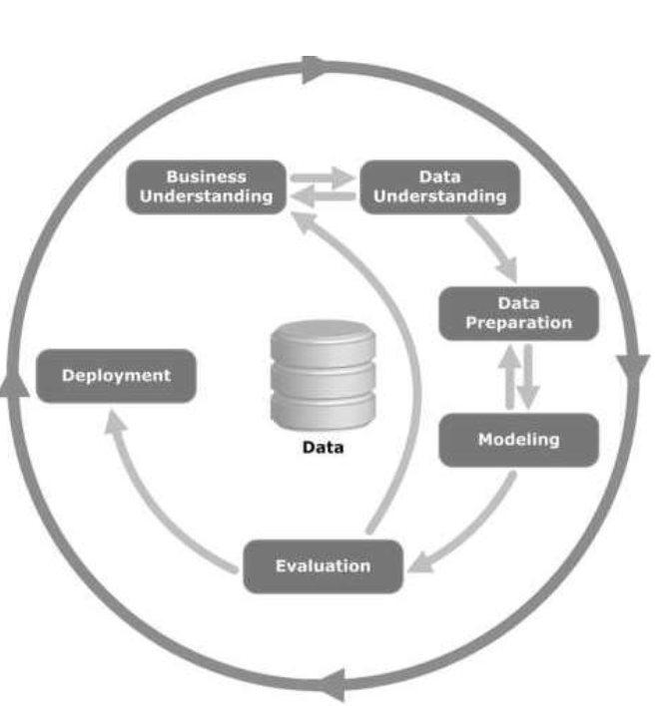
PROCESS
Data Collection –
All vehicle loans disbursed in Aug2018, Sep2018 and Oct2018
Borrower details
Borrower credit bureau information
Loan disbursement date and amount
1st month repayment flag after loan disbursement.
Data Preparation –
Importing data from raw csv files
Preparation of model variables
Random sampling – All loan defaults were sampled into trained (70%) and test (30%) sample.
Analyze the correlation with in IDV’s.
Analyze the predictive power of each IDV using Information value (IV).
Variable transformation - All IDVs were binned based on Weight of Evidence.

Slide 7
PROCESS
Analysis and Modelling –
Fitting logistic regression over train sample.
Assess the discrimination power of the proposed model on train sample.
Conversion of logodds to scaled score
Validation -
Assess the proposed model (scaled score) performance for its stability, strength and accuracy on the test sample.
Stability Metrics – PSI ,VDI
Stability metrics infer the deviation of the test sample from the train sample .
It is very important to understand the model is used on the right population for which it is trained.
Strength Metrics – Gini, AUC, Confusion matrix ,Accuracy Index
It describes the discrimination power to identify the bads as different from goods.
Accuracy Metrics – Odds at Base score, PDO
It describes how accurately the bads are identified from goods.
Conclusion – Constructive solution to identify the defaults.

Slide 8
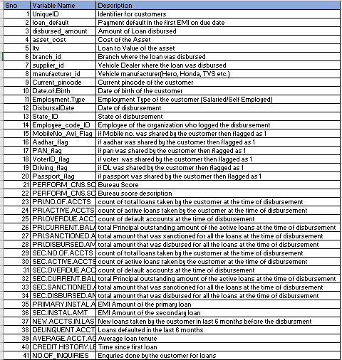
Data Collection
https://www.kaggle.com/mamtadhaker/lt-vehicle-loan-default-prediction
Number of loans disbursed = 233154
Features in dataset = 41
This dataset contains information on
Borrower’s Information (Demographic data like age, Identity proof etc.)
Bureau data & history (Bureau score, number of active accounts, the status of other loans, credit history etc.).
Loan Information (Disbursal details, loan to value ratio etc.)
Default Flag (1-Fail to pay the first EMI; 0-Otherwise)
All vehicle loans disbursed in Aug2018, Sep2018 and Oct2018
There is missing information of Employment type

Slide 9
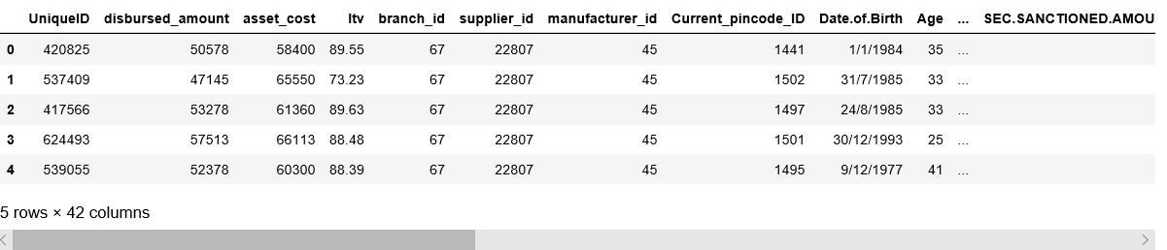
Data collection –Importing data

Slide 10
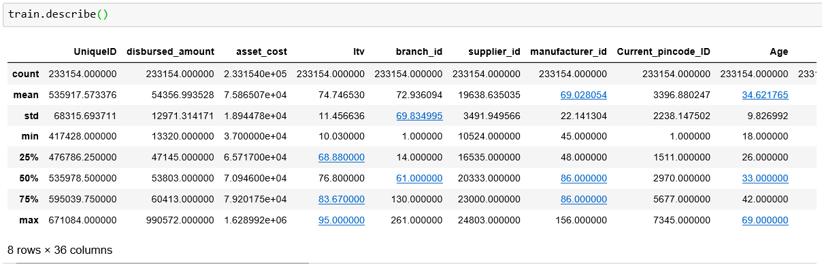
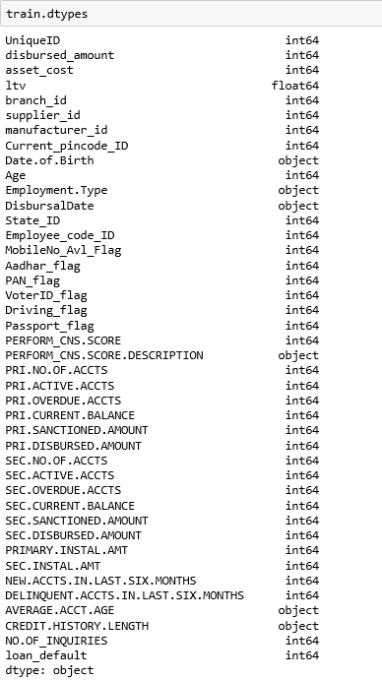
Data collection –Describing data
Data Description
Features - Data Type

Slide 11
Data Collection - Summary
Categorical Variables | Numeric Variables | Date Variables | Target Variable
Employment. Type, | disbursed_amount, LTV, asset_cost | Date of Birth ( converted to Age) | The loan_default variable (y) indicates whether that customer had default payment the next month or not. If yes, it is labeled 1,otherwise, set to 0.
MobileNo_Avl_Flag, Aadhar_flag, PAN_flag, VoterID_flag, Driving_flag, Passport_flag | Primary Account details: Number of active accounts, no. of over due accounts , current balance, disbursal amount etc. | DisbursalDate
PERFORM_CNS.SCORE and PERFORM_CNS.SCORE.DESCRIPTION (will be converted to category) | Secondary Account details Number of active accounts no of over due accounts current balance, disbursal amount | CREDIT.HISTORY.LENGTH & AVERAGE.ACCT.AGE which will be converted into number of months.

Slide 12
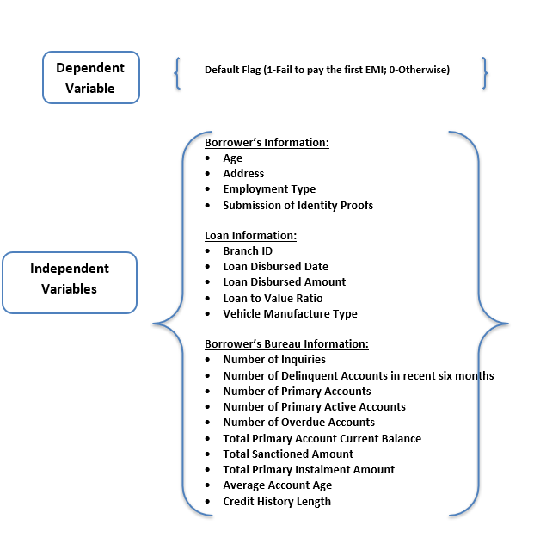
Data preparation - Model Variables

Slide 13
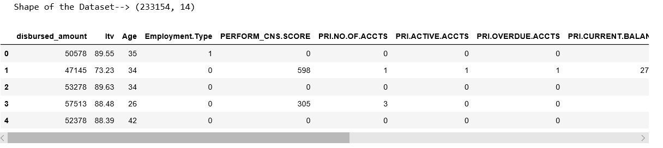
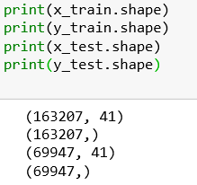
Data preparation - Sampling
Random sampling – split all disbursed loan data into train and test samples.
Train sample = 70% of randomly chosen disbursed loans .
Test sample = 30% of remaining disbursed loans.

Slide 14
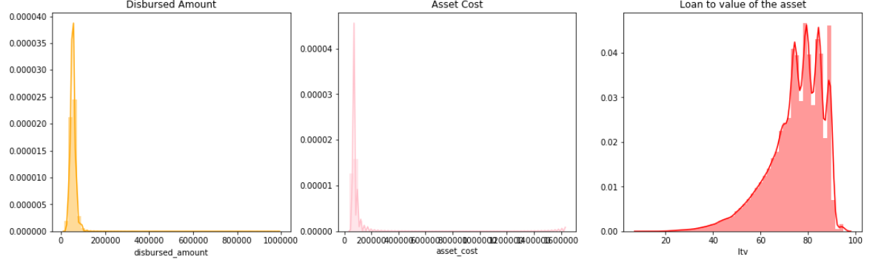
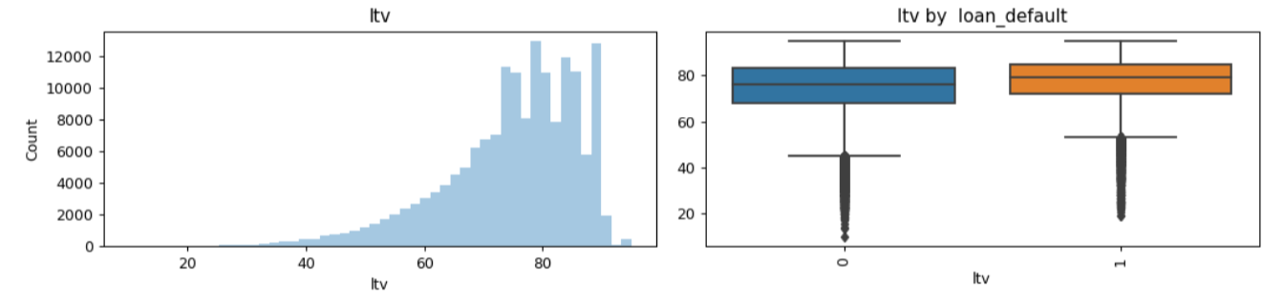
Data preparation - Exploring loan features on Train Data
Disbursed Loan :Most of the Loans are ranging from 10,000 to 1,65,000
Asset Cost :Ranges from 40,000 to 2,25000 .
Loan to Value ratio: Ranged from 10 to 95 ,which is inline with disbursed loan and Asset loan

Slide 15
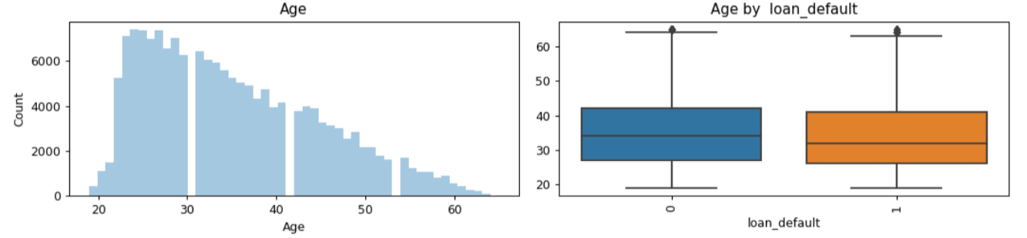
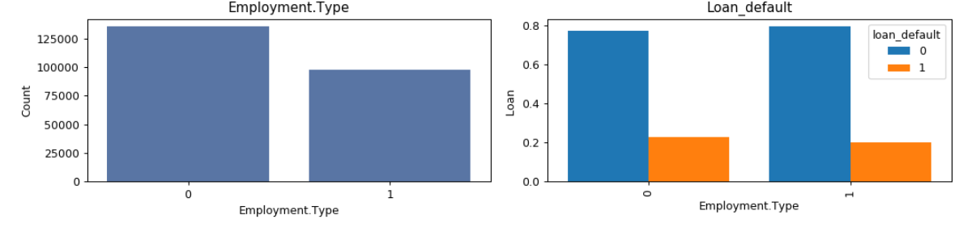
Data preparation - Exploring Borrower features on Train Data
Age
we see that most age groups are concentrated in 25-40 years.
The loan default are distributed in low range of age.
Employment type
Most of the borrowers were self-employed.
The default loans are from self-employment group.

Slide 16
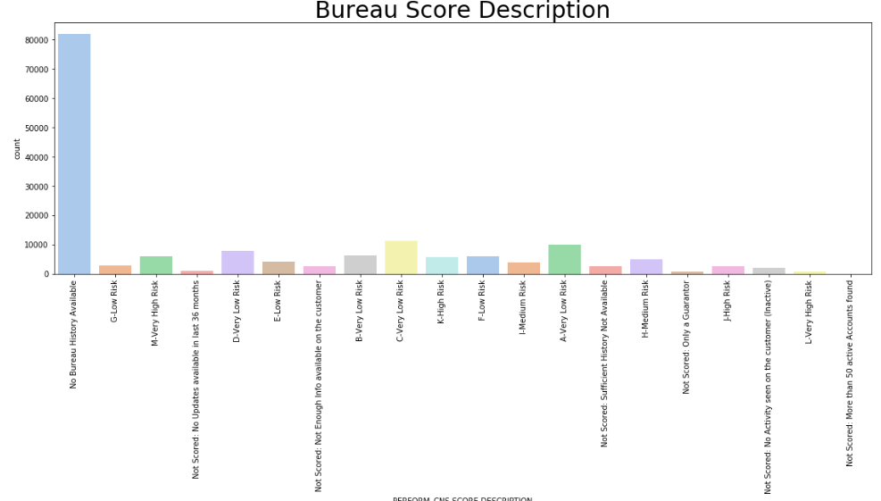
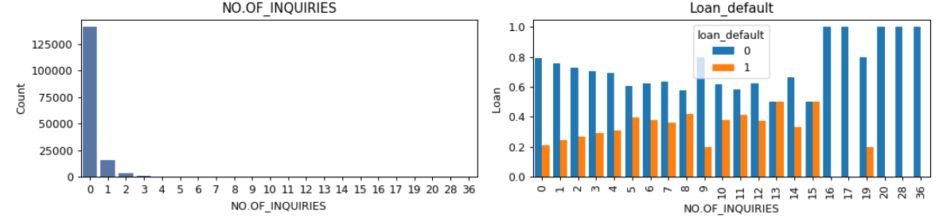
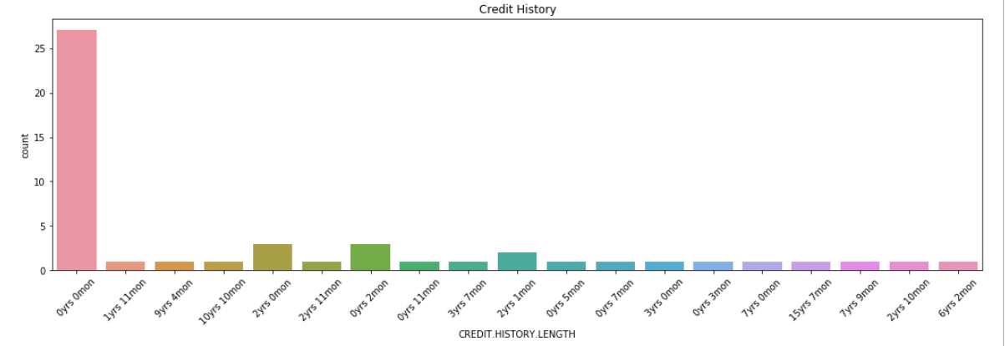
Data preparation - Exploring Bureau Features on Train Data
Perform_Cns_Score
Most of the loans have no score .
Most of the default loans are from no-score zone.
No of Inquiries
Higher the number on inquires higher is the default rate.
Length of Credit History
Most of the loans doesn’t have bureau credit history.
Higher the credit history the lower the risk of default

Slide 17
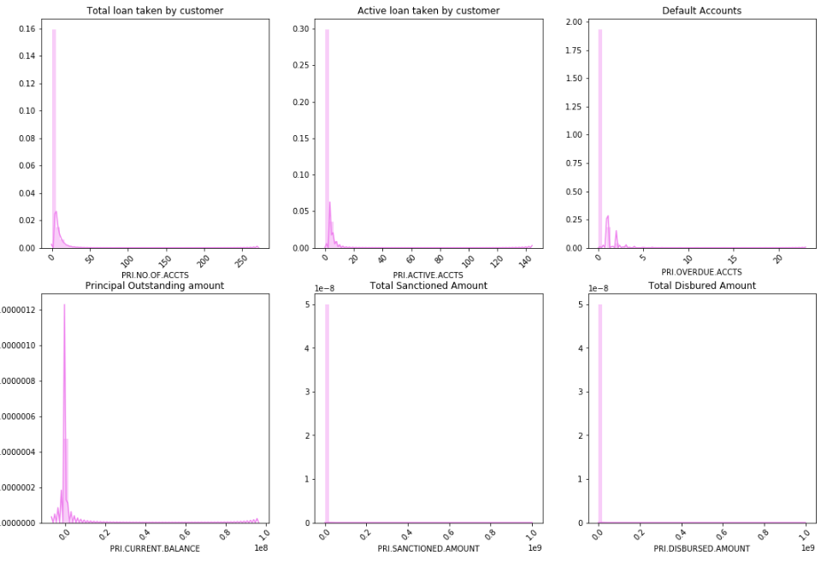
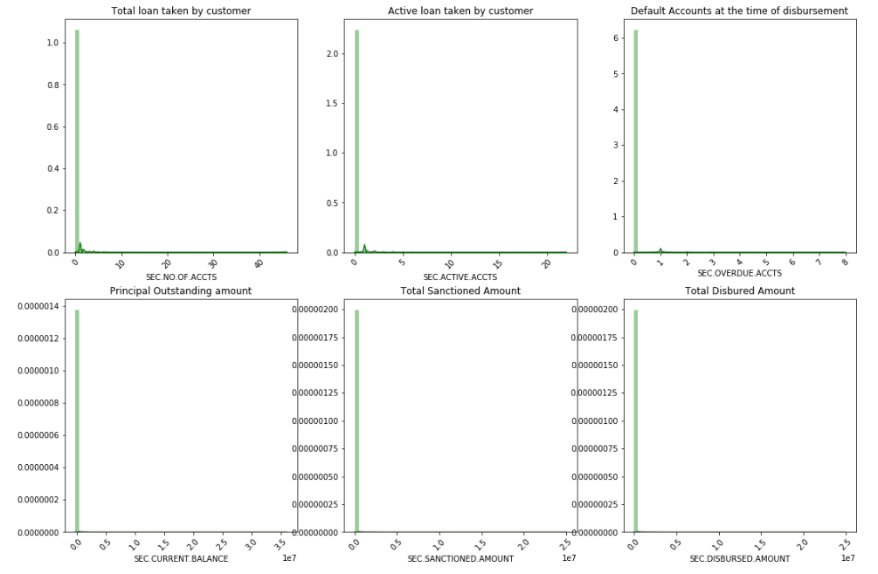
Data preparation - Exploring Bureau information on Train Data
Primary Loan Data :
Secondary Loan Data:
The Variation in secondary Loan details are not much and hence these variable can be considered as redundant

Slide 18
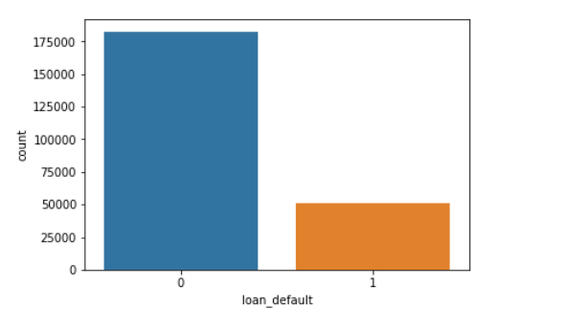
Data preparation - Default Flag
Loan_Default:
Binary variable: 0 – Non-default and 1- Default.
Observed 22% default rate on both train and test samples.
Default refers to the failed to repay the loan amount for the first EMI.
Bank notifies high rollback rates (90%) from default to non-default from the second installment.
performance metrics used for Prediction :
Area under ROC
Confusion Matrix
Precision : It is the fraction of relevant instances among the retrieved instances
Recall : It is the fraction of relevant instances that have been retrieved over the total amount of relevant instances.
F1 Score : It is the harmonic average of the precision and recall

Slide 19
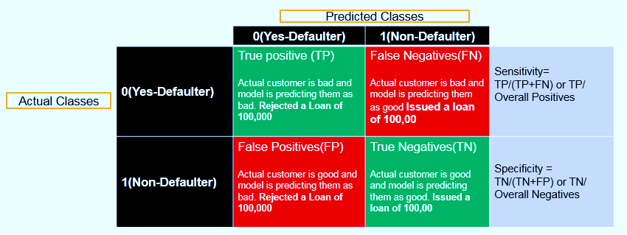
Confusion matrix
Confusion matrix
Predicting a bad defaulters before issuing the loan:
If p is probability of default then we would like to set our threshold in such a way that we don’t miss any of the bad customers.
We set the threshold in such a way that Sensitivity is high.
We can compromise on specificity here. If we wrongly reject a good customer, our loss is very less compared to giving a loan to a bad customer.
We don’t really worry about the good customers here, they are not harmful hence we can have less Specificity.
Sensitivity is the factor that we need to concentrate upon.

Slide 20
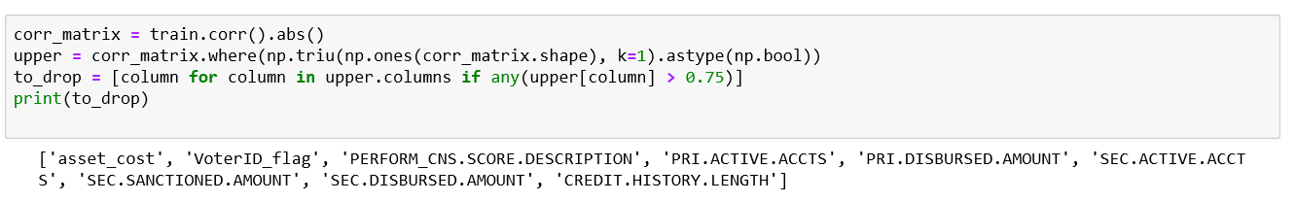
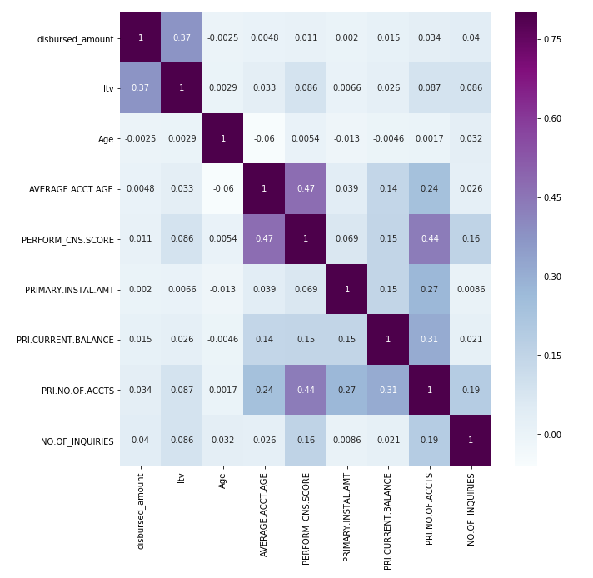
Data Preparation – Correlation matrix
High Colinear Variables :
To avoid Multicollinearity the high correlated coefficients are removed ,by keeping only one variable of such group
Between the high correlated variables we have chosen the high IV(Information value)
After removing High Correlated variables

Slide 21
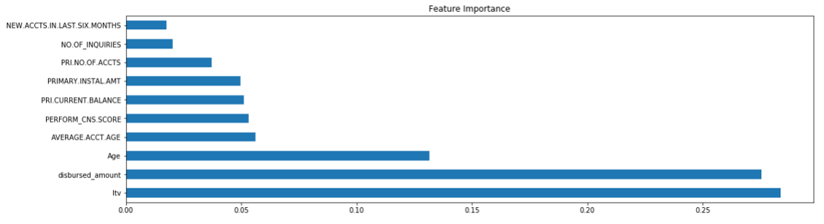
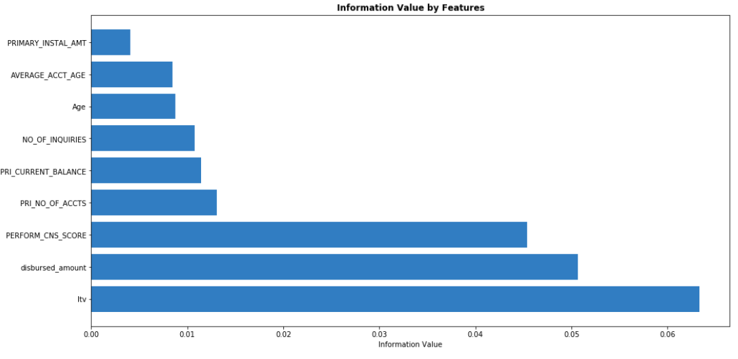
Data Preparation – Feature Engineering(IDV ‘s)
Impute Missing values:
Filled missing values of Employment.type with ‘Salaried’ or ‘Self employed’ using relevant bureau score.
Transformation of variables:
String values have been formatted to integers.
Categorical values have been transformed to numerical.
Reducing Redundancy :
Removed the IDV’s with low variance and IV
Bureau data – all features on secondary account were removed.
All features related Customer identity proof were removed as the information is identical and low IV.
Generated the correlation matrix for all IDVs.
Among the highly correlated pair of IDV’s the one with low IV was removed.
Leftover features were ranked by IV and ExtraTreeClassifier score.

Slide 22
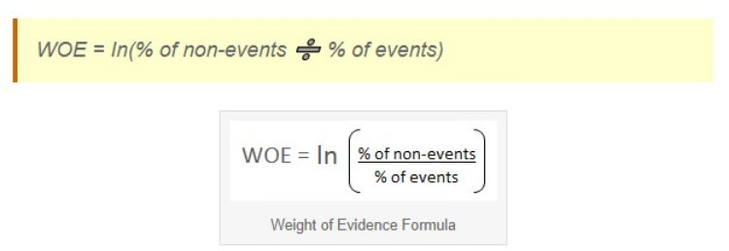
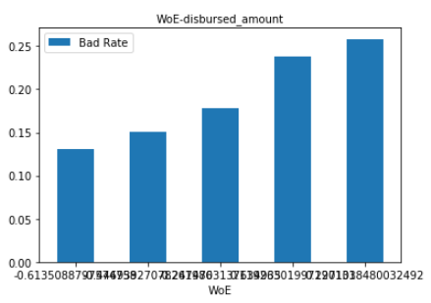
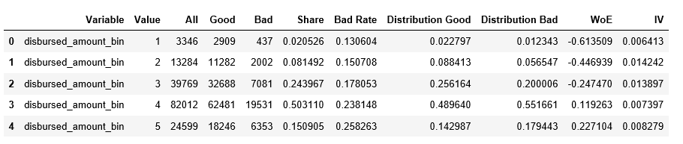
Data Preparation - Discretizing Predictors/Binning(WOE)
Transformation of IDVs (using WOE):
All the numerical values were binned based on the ‘Weight of Evidence’.
By using proper binning technique, it can establish monotonic relationship (either increase or decrease) between the independent and dependent variable
This methods handles the outliers and the necessary for one hot encoding is removed.
Information value of each predictors is calculated by binning the each IDV .

Slide 23
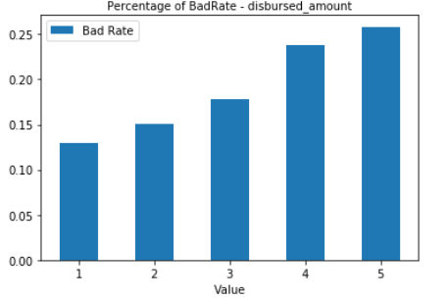
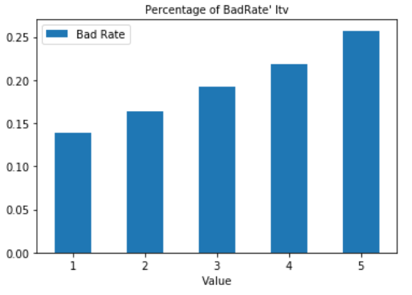
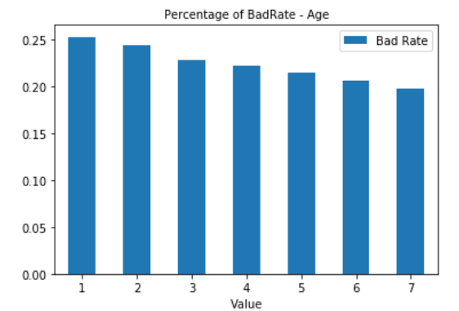
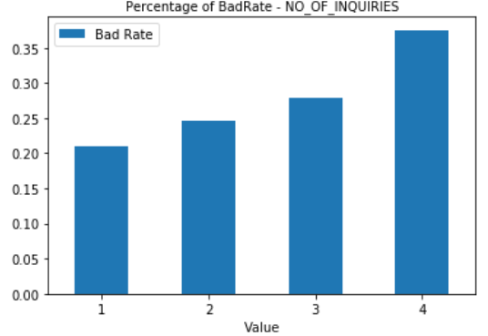
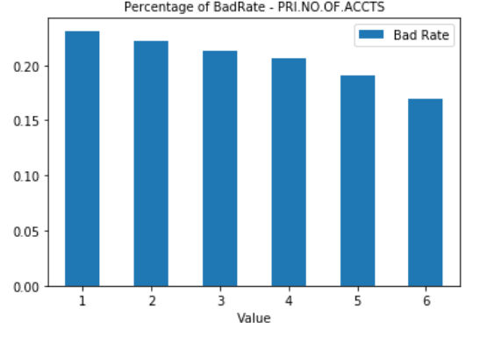
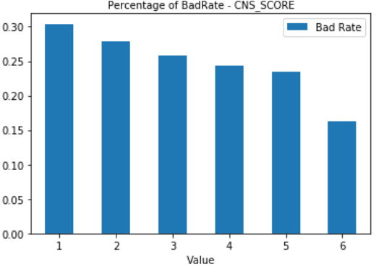
Data Preparation – IDV Bins and Bad rates

Slide 24
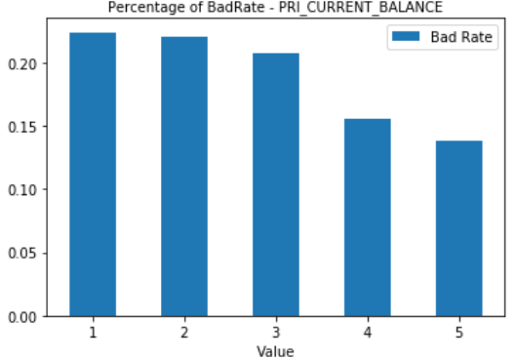
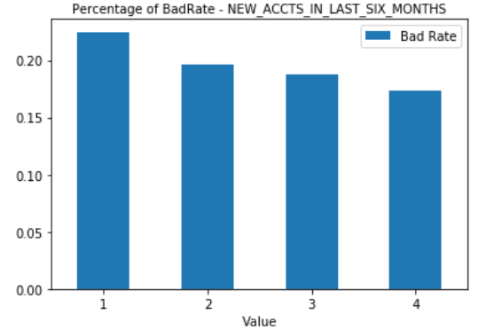
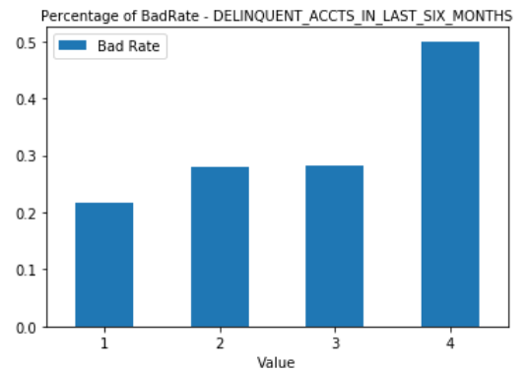
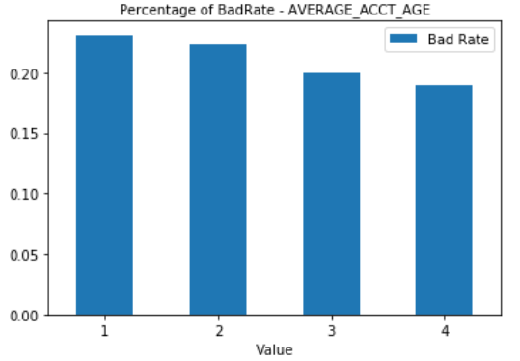
Data Preparation – IDV Bins and Bad rates

Slide 25
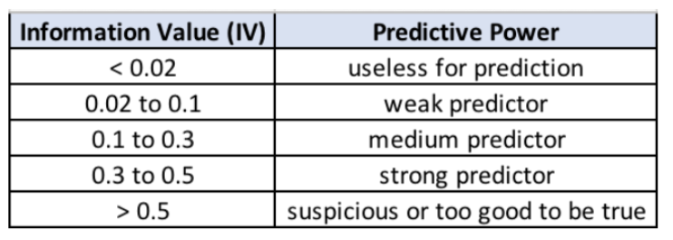
Data Preparation– Stability Metrics
Variable | IV_Values | VDI Values | GINI Index
disbursed_amount | 0.50229 | 0.000012 | 0.600000
ltv | 0.62931 | 0.000064 | 0.600000
Age | 0.08620 | 0.046196 | 0.562500
PERFORM_CNS_SCORE | 0.45099 | 0.000107 | 0.583333
PRI_NO_OF_ACCTS | 0.12769 | 0.000097 | 0.583333
PRI_CURRENT_BALANCE | 0.11220 | 0.000004 | 0.625000
PRIMARY.INSTAL.AMT | 0.03794 | 0.000082 | 0.625000
AVERAGE_ACCT_AGE | 0.08297 | 0.000039 | 0.625000
NO_OF_INQUIRIES | 0.10765 | 0.000190 | 0.625000
Information Value(IV):
The information value provides the information of how the variable is significant in prediction of the target variable
Variable Deviation Index (VDI) :
It provides the information of how the test and train samples are similar to each other.
The lower the value the better its for model.
Gini Index :
Gini metric to measure the performance of the model. It represents a good variable for prediction if the range is more than 50%

Slide 26
Analysis & Modelling – IDV relation
Variable | Bad Rate | Model Coefficient | IV Value
disbursed_amount | Increase | Positive | 0.0558
ltv | Increase | Positive | 0.0633
Age | Decrease | Negative | 0.008612
PERFORM_CNS_SCORE | Decrease | Negative | 0.04541
PRI_NO_OF_ACCTS | Decrease | Negative | 0.013038
PRI_CURRENT_BALANCE | Decrease | Negative | 0.010137
NEW_ACCTS_IN_LAST_SIX_MONTHS | Decrease | Negative | 0.008054
PRIMARY.INSTAL.AMT | Decrease | Negative | 0.001748
AVERAGE_ACCT_AGE | Decrease | Negative | 0.008422
NO_OF_INQUIRIES | Increase | Positive | 0.010788
Continuous Variables:
All the ID variables are in increasing order i.e from minimum to maximum.
The Model Coefficient is the sign that is expected to be present in the log odds of the Logistic regression.
The weightage is provided in accordance with the Information Value.
Categorical Variables :
The sign of model coefficient need not be considered.

Slide 27
Analysis & Modelling – techniques Adopted
Logistic Regression:
Logistic Regression is used solve the classification problem of identifying the customer who becomes default in paying the 1st month installment based on the borrowers credit bureau information and the loan details .
Decision tree :
Decision tree is used as one of the classifiers to solve the classification problem of identifying the customer who becomes default in paying the 1st month installment based on the borrowers credit bureau information and the loan details .
Due to ease of understanding of decision trees over regression , we have chosen the decision tree classifier.
Random forest Tree Classifier
Random Forest is a flexible, easy to use machine learning algorithm that produces, even without hyper-parameter tuning, a great result most of the time.
Random forest builds multiple decision trees and merges them together to get a more accurate and stable prediction of defaulters over non defaulters.
As the proportion of non defaulters is dominating the defaulters information, we have chosen this method so that we can acquire more sensitivity and specificity at same time.

Slide 28
Analysis & Modelling – techniques Adopted
Gradient boosting Classifier
This machine learning technique produces a prediction of the model in the form of an ensemble of weak prediction models, typically decision trees. It trains the model in a gradual, additive and sequential manner.
It build trees one at a time, where each new tree helps to correct errors made by previously trained tree thus resulting in a stronger learning model that predicts user ratings better.
This ensemble model is chosen to get high accurate results.
AdaBoost :
AdaBoost was designed in such a way that at every step the sample distribution was adapted to put more weight on misclassified samples and less weight on correctly classified samples. The final prediction is a weighted average of all the weak learners, where more weight is placed on stronger learners.
As the contribution of defaulters in the train sample is less the more chances of weak learners are more, so Ada booster classifier is chosen keeping this in mind.
growing the same leaf, Leaf-wise algorithm can reduce more loss than a level-wise algorithm.

Slide 29
Analysis & Modelling – techniques Adopted
Voting Classifier
A Voting Classifier is used to wrap the models and average the predictions of the sub-models .It takes the most commonly occurring class (i.e. mode as voting parameter was set to hard ) among all of the predicted class labels to be the predicted output of the ensemble. This method is also known as the Majority Vote method.
This method couldn't make much distinguishing between default and non defaulters because both the models used turned out to be weak learners.
LGBM Classifier :
Light GBM grows tree vertically while other algorithm grows trees horizontally meaning that Light GBM grows tree leaf-wise while other algorithm grows level-wise. It will choose the leaf with max delta loss to grow. When growing the same leaf, Leaf-wise algorithm can reduce more loss than a level-wise algorithm.
A grid search is also applied to high sensitivity and high specificity at the same time.
This ensemble model turned out to be useful.

Slide 30
Analysis and Modelling –Python code
Models | Fitting Train data | Predictions- Train data | Performance Metrics -train data | Prediction on Test data | Validation - performance Metrics Test data
Logistic Regression | logisticRegr_norm = LogisticRegression() logisticRegr_norm.fit(x_train, y_train) | lr_pred_norm_t= logisticRegr_norm.predict(x_train) lpred_proba_norm_t =logisticRegr_norm.predict_proba(x_train) | evaluate_model(y_train, new_pred_default_class_t, lpred_proba_norm_t) | lr_pred_norm = logisticRegr_norm.predict(x_test) lpred_proba_norm =logisticRegr_norm.predict_proba(x_test) | evaluate_model(y_train, new_pred_default_class, lpred_proba_norm)
Decision Tree | clf_d=tree.DecisionTreeClassifier(random_state=23) clf_d.fit(x_train, y_train) | predictions_train_d = clf_d.predict(x_train) predict_prob_train=clf_d.predict_proba(x_train) | evaluate_model(y_train, predictions_train_d,predict_prob_train) | predictions_d = clf_d.predict(x_test) predict_prob=clf_d.predict_proba(x_test) | evaluate_model(y_test, predictions_test_d,predict_prob_test)
Decision Tree(Grid Search CV) | mod_cv=model_selection.GridSearchCV(clf_op,param_grid=[{'max_depth':[2,3,4,5,6,7,None],"max_features":[1,2,3,4]}],cv=10) mod_cv.fitx_train, y_train) | predictions_train_op = clf_op.predict(x_train) predict_prob_train_op=clf_op.predict_proba(x_train) | evaluate_model(y_train, predictions_train_op,predict_prob_train_op) | predictions_op = clf_op.predict(x_test) predict_prob_op=clf_op.predict_proba(x_test) | evaluate_model(y_test, predictions_op,predict_prob_op)
Random Forest | Rf = BalancedRandomForestClassifier(max_depth=6,verbose=True,random_state=10,n_estimators=500) Rf.fit(x_train, y_train) | y_train_pred = Rf.predict(x_train) y_train_prob =Rf.predict_proba(x_train) | evaluate_model(y_train, y_train_pred,y_train_prob) | y_pred = Rf.predict(x_test) y_pred_prob = Rf.predict_proba(x_test) | evaluate_model(y_test, y_pred,y_pred_prob)
Gradient Boosting | gb_model = GradientBoostingRegressor(max_depth=8, n_estimators=250, learning_rate=0.01, random_state=123) gb_model.fit(x_train, y_train) | predictions_train = gb_model.predict(x_train) | evaluate_model(y_train,predictions_train.round(), predictions_train) | predictions = gb_model.predict(x_test) | evaluate_model(y_test,predictions.round(), predictions)

Slide 31
Analysis and Modelling –Python code
Models | Fitting Train data | Predictions- Train data | Performance Metrics -train data | Prediction on Test data | Validation - performance Metrics Test data
Ada Boosting | ada_model = AdaBoostRegressor(DecisionTreeRegressor(max_depth=6), n_estimators=200, learning_rate=0.01, random_state=123) ada_model.fit(x_train, y_train) | predictions = ada_model.predict(x_train) | evaluate_model(y_train, predictions.round(),predictions) | predictions = ada_model.predict(x_test) | evaluate_model(y_test, predictions.round(),predictions)
Voting Classifiers | log_model = LogisticRegression() dtree_model = DecisionTreeClassifier() ensemble = VotingClassifier(estimators=[('lr', log_model), ('dtree', dtree_model)], voting='hard') ensemble.fit(x_train, y_train) | predictions = model.predict(x_train) | print(model.__class__.__name__, 'Precision-->',precision_score(y_train, predictions)) | predictions = model.predict(x_test) | print(model.__class__.__name__, 'Precision-->',precision_score(y_test, predictions))
LGBMClassifier | clf1 = LGBMClassifier(random_state=25) clf1.fit(x_train, y_train) clf2 = LGBMClassifier( random_state=25) clf2.fit(xtrain_min_up, ytrain_min_up) clf3 = LGBMClassifier( random_state=25) clf3.fit(xtrain_maj_down, ytrain_maj_down) clf4 = LGBMClassifier(random_state=25) clf4.fit(xtrain_smote, ytrain_smote) clf5 = LGBMClassifier(random_state=25, class_weight={0: 0.6386298893393229, 1: 1.5}) clf5.fit(x_train, y_train) | yp1 = clf1.predict(x_train) yp2 = clf2.predict(x_train) yp3 = clf3.predict(x_train) yp4 = clf4.predict(x_train) yp5 = clf5.predict(x_train) yp = (yp1 + yp2 + yp3 + yp4 + yp5)/5 | evaluate_model(y_train,yp.round(), yp) | yp1 = clf1.predict(x_test) yp2 = clf2.predict(x_test) yp3 = clf3.predict(x_test) yp4 = clf4.predict(x_test) yp5 = clf5.predict(x_test) yp = (yp1 + yp2 + yp3 + yp4 + yp5)/5 | evaluate_model(y_test,yp.round(), yp)

Slide 32
Analysis and Modelling – examining the models (Performance on Train sample)
Models | AUC | F1 | Precision | Recall | Accuracy | Confusion Matrix
Logistic Regression | 61% | 38% | 50% | 63% | 60% | [[29000 25708] [ 5580 9596]]
Decision Tree | 58% | 38% | 27% | 66% | 54% | [[64675 62931] [12058 23346]]
Random Forest | 58% | 38% | 27% | 67% | 53% | [[63383 64223] [11748 23656]]
Gradient Boosting | 59% | 39% | 28% | 62% | 57% | [[70649 56957] [13363 22041]]
Ada Boosting | 58% | 38% | 27% | 66% | 54% | [[64225 63381] [11992 23412]]
Voting Classifiers | 51% | 0% | 93% | 0% | 78% | [[127605 1] [ 35391 13]]
LGBMClassifier | 62% | 36% | 30% | 47% | 64% | [[88033 39573] [18671 16733]]
LGBMClassifier -GRID Search CV | 62% | 38% | 28% | 60% | 58% | [[73158 54448] [14124 21280]]

Slide 33
Validation – examining the models (Performance on test sample)
Models | AUC | F1 | Precision | Recall | Accuracy | Confusion Matrix
Logistic Regression | 61% | 38% | 27% | 63% | 55% | [[29000 25708] [ 5580 9596]]
Decision Tree | 61% | 38% | 27% | 65% | 54% | [[27802 26906] [ 5245 9931]]
Random Forest | 61% | 38% | 27% | 67% | 54% | [[27420 27288] [ 5074 10102]]
Gradient Boosting | 58% | 38% | 28% | 60% | 58% | [[31096 23612] [ 6071 9105]]
Ada Boosting | 58% | 38% | 27% | 65% | 54% | [[28033 26675] [ 5310 9866]]
Voting Classifiers | 57% | 0% | 43% | 0% | 78% | [[54704 4] [15173 3]]
LGBMClassifier | 61% | 36% | 29% | 46% | 64% | [[37854 16910] [ 8185 6998]]
LGBMClassifier -GRID Search CV | 61% | 38% | 28% | 58% | 58% | [[31971 22737] [ 6385 8791]]

Slide 34
Analysis and Modelling – Evaluation of Models
Model using logistic regression vs Other models
The performance of the model using logistic regression is at par with other models on train sample.
The performance on test sample is consistent and at par with the respective model’s performance on train sample.
This concludes there is no overfit of all the model on the train sample.
Acceptable model performance : Model using logistic regression
The AUC (>60%) and Accuracy index (>50%) on both train and test samples.
The performance of the model has not improved even after including all IDV’s (with no exclusions) in the train sample.
This concludes the unexplained DV is due lack of appropriate IDV’s in the data and not necessarily because of the error in the regression fit.

Slide 35
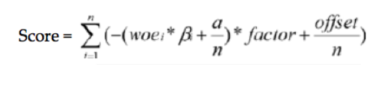
Analysis and Modelling – Scaled score
We choose to scale the points such that a total score of 500 points corresponds to good/bad odds of 1 to 1 and an increase of the score of 200 points corresponds to a doubling of the good/bad odds.
Scaling — the choice of scaling does not affect the predictive strength of the scorecard
Points to double the odds’ (pdo = 200)
Factor = pdo / ln(2)
Offset = Score — {Factor * ln(Odds)}
Score Bin | Min | Max | Count | Bads | BadRate
1 | 0 | 399 | 0 | 0
2 | 400 | 449 | 4 | 0 | 0%
3 | 450 | 499 | 28 | 15 | 54%
4 | 500 | 549 | 115 | 48 | 42%
5 | 550 | 599 | 198 | 82 | 41%
6 | 600 | 649 | 759 | 298 | 39%
7 | 650 | 699 | 3291 | 1087 | 33%
8 | 700 | 749 | 6936 | 2146 | 31%
9 | 750 | 799 | 35784 | 10055 | 28%
10 | 800 | 849 | 26692 | 6712 | 25%
11 | 850 | 899 | 18829 | 4112 | 22%
12 | 900 | 949 | 26926 | 4891 | 18%
13 | 950 | 999 | 16892 | 2690 | 16%
14 | 1000 | 1049 | 13791 | 1869 | 14%
15 | 1050 | 1099 | 6293 | 751 | 12%
16 | 1100 | 1149 | 3034 | 341 | 11%
17 | 1150 | 1199 | 2496 | 238 | 10%
18 | 1200 | 1249 | 930 | 81 | 9%
19 | 1250 | 1299 | 106 | 7 | 7%
20 | 1300 | 1350 | 103 | 5 | 5%
Scaled score bins on train sample:

Slide 36
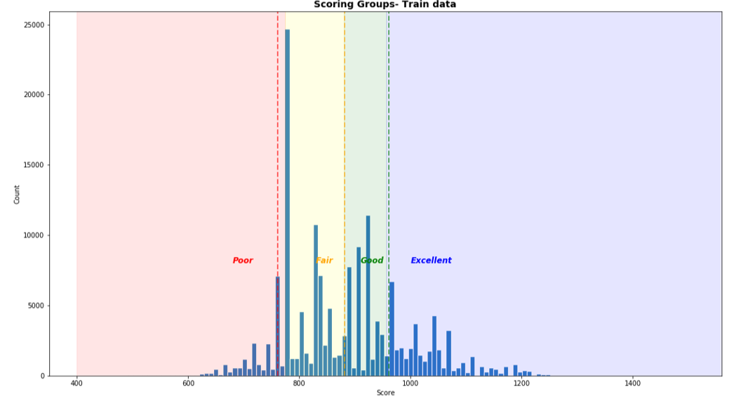
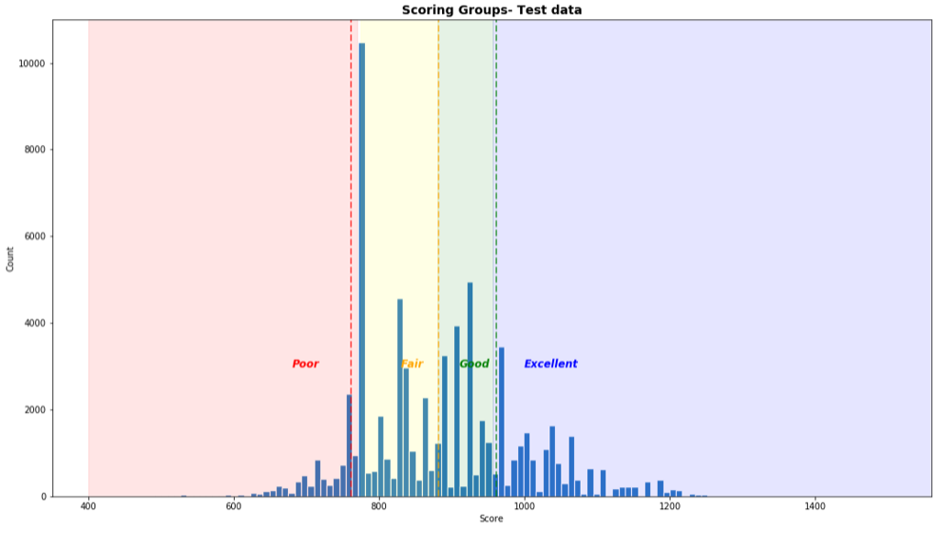
Scaled score – Distribution on train and test sample
The regression coefficients developed using Logistic regression are used to scale the scorecard.
Scaling a scorecard refers to making the scorecard conform to a particular range of scores
We can observe that the train and test data are having very much similar groups in the score bands.
The score bands are further examined to determine the cut off of the score bands so as to maximize the profit by having minimal or optimal rejection rate with maximum profit by having lower default rate.

Slide 37
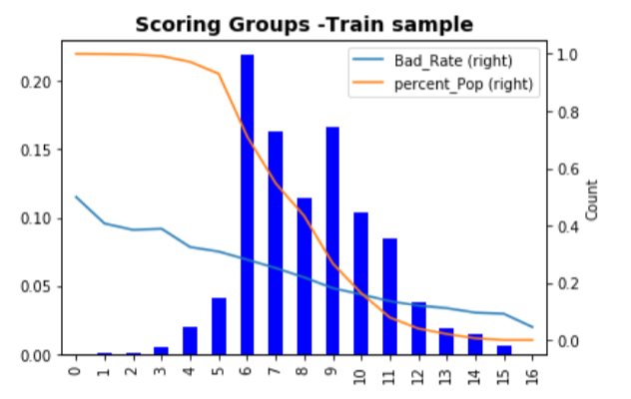
Scaled score – Distribution on train sample
Score Bin | Min | Max
1 | 0 | 399
2 | 400 | 449
3 | 450 | 499
4 | 500 | 549
5 | 550 | 599
6 | 600 | 649
7 | 650 | 699
8 | 700 | 749
9 | 750 | 799
10 | 800 | 849
11 | 850 | 899
12 | 900 | 949
13 | 950 | 999
14 | 1000 | 1049
15 | 1050 | 1099
16 | 1100 | 1149
17 | 1150 | 1200

Slide 38
Scaled score – Cut off points
Scaled score
Bin | Min | Max | Count | Bads | Badrate
1 | 0 | 399 | - | -
2 | 400 | 449 | 4 | - | 0%
3 | 450 | 499 | 28 | 15 | 54%
4 | 500 | 549 | 115 | 48 | 42%
5 | 550 | 599 | 198 | 82 | 41%
6 | 600 | 649 | 759 | 298 | 39%
7 | 650 | 699 | 3,291 | 1,087 | 33%
8 | 700 | 749 | 6,936 | 2,146 | 31%
9 | 750 | 799 | 35,784 | 10,055 | 28%
10 | 800 | 849 | 26,692 | 6,712 | 25%
11 | 850 | 899 | 18,829 | 4,112 | 22%
12 | 900 | 949 | 26,926 | 4,891 | 18%
13 | 950 | 999 | 16,892 | 2,690 | 16%
14 | 1000 | 1049 | 13,791 | 1,869 | 14%
15 | 1050 | 1099 | 6,293 | 751 | 12%
16 | 1100 | 1149 | 3,034 | 341 | 11%
17 | 1150 | 1199 | 2,496 | 238 | 10%
18 | 1200 | 1249 | 930 | 81 | 9%
19 | 1250 | 1299 | 106 | 7 | 7%
20 | 1300 | 1350 | 103 | 5 | 5%
Overall |  |  | 163,207 | 35,428
% Accepted |  |  | 100%
% Badrate |  |  | 22%
Cutoff | % Accepted | Count | Bads | BadRate
500 | 100% | 163,175 | 35,413 | 22%
700 | 97% | 158,812 | 33,898 | 21%
800 | 71% | 116,092 | 21,697 | 19%
850 | 55% | 89,400 | 14,985 | 17%
900 | 43% | 70,571 | 10,873 | 15%
950 | 27% | 43,645 | 5,982 | 14%
Hard cutoff:
Selects one score cutoff point to accept/reject the loan application
The optimal score was chosen to maximize the approval rate and minimize bad rate.
Pros:
Simple decisioning platform for loan approval process
Cons:
Cannot explore the behavior of the borrowers in future with scores less than cutoff point.
Soft cutoff:
Selects optimal % Acceptance for each score bin to accept/reject the loan application
The optimal % Acceptance was chosen to maximize the approval rate and minimize bad rate.
Pros:
Allows to study behavior of low scored borrowers in future and can be used for model enhancement.
Bad rate was improved from 22% to 19% on train sample.
Compare to hard cutoff, have better % Acceptance with same Bad rate.
Cons:
Forces to maintain the tracker on daily or weekly basis to control the % Acceptance for low score borrowers.
Hard cutoff
% Accepted | Score Bin | Min | Max | Count | Bads | BadRate
0% | 1 | 0 | 399 | - | -
0% | 2 | 400 | 449 | - | -
10% | 3 | 450 | 499 | 3 | 2 | 54%
10% | 4 | 500 | 549 | 12 | 5 | 42%
10% | 5 | 550 | 599 | 20 | 8 | 41%
10% | 6 | 600 | 649 | 76 | 30 | 39%
20% | 7 | 650 | 699 | 658 | 217 | 33%
20% | 8 | 700 | 749 | 1,387 | 429 | 31%
20% | 9 | 750 | 799 | 7,157 | 2,011 | 28%
90% | 10 | 800 | 849 | 24,023 | 6,041 | 25%
100% | 11 | 850 | 899 | 18,829 | 4,112 | 22%
100% | 12 | 900 | 949 | 26,926 | 4,891 | 18%
100% | 13 | 950 | 999 | 16,892 | 2,690 | 16%
100% | 14 | 1000 | 1049 | 13,791 | 1,869 | 14%
100% | 15 | 1050 | 1099 | 6,293 | 751 | 12%
100% | 16 | 1100 | 1149 | 3,034 | 341 | 11%
100% | 17 | 1150 | 1199 | 2,496 | 238 | 10%
100% | 18 | 1200 | 1249 | 930 | 81 | 9%
100% | 19 | 1250 | 1299 | 106 | 7 | 7%
100% | 20 | 1300 | 1350 | 103 | 5 | 5%
 | Overall |  |  | 122,735 | 23,728
 | % Accepted |  |  | 75%
 | % Badrate |  |  | 19%
Soft cutoff

Slide 39
Scaled score – Summary (Proposed solution)
Current Approval Process:
New loan portfolio with no analytical decision scorecard.
22% of disbursed loans have failed to make first EMI.
90% rollback from default to non-default on the second EMI.
Proposed Scorecard (Soft cutoff - optimal % Acceptance for each score bin):
Scores the borrower based on his Personal and Credit bureau information.
Facilitate to study the behavior of low scored customer for future model enhancements.
Attract more borrowers in high score bins by discounted loan interest rate.
The risk of high default rate for low scored borrowers can be adjusted with high interest rates.
Assumptions and Limitations:
There is no data of the rejected loan applications. It was assumed that most of loan rejects fall in the lower scored buckets. So that these applications are filtered in future with the % Acceptance in low scored bins.
The model data does not have variables related to Borrower’s Income ,recent transaction history and Debt. Inclusion of these variables will enhance the model performance.

Slide 40
Challenges:
Challenges
As the contribution of default loans are less compared to non defaulters ,choosing the performance metrics was challenging.
Tried with different techniques of resampling techniques lie minor upsample, majority downsample, SMOTE , applying balanced weights.
One of the major challenges we faced was Converting categorical data into quantifiable data to apply classification models was another major challenge as our attributes were in one column.
Making bins for every variable was involved with much effort , tried binns with decision tree which didn’t help much. So carried on with the manual binning .
As most of models had same sensitivity in predicting the defaulters ,tried almost all the models ending up with same percent of prediction of default rate.

Slide 41
Appendix A
Data Set:
https://www.kaggle.com/mamtadhaker/lt-vehicle-loan-default-prediction
Feature Descriptions / Markdown :
Mentioned in jupyter notebook submitted.

Slide 42
Appendix B : Importing & Reading Dataset

Slide 43
Appendix B : Describing Dataset
•Describe the data
•Describe the Data Type

Slide 44
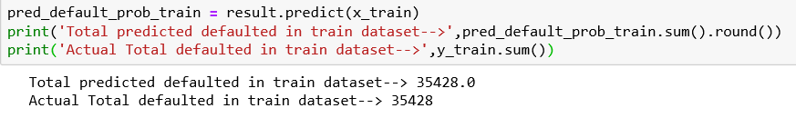
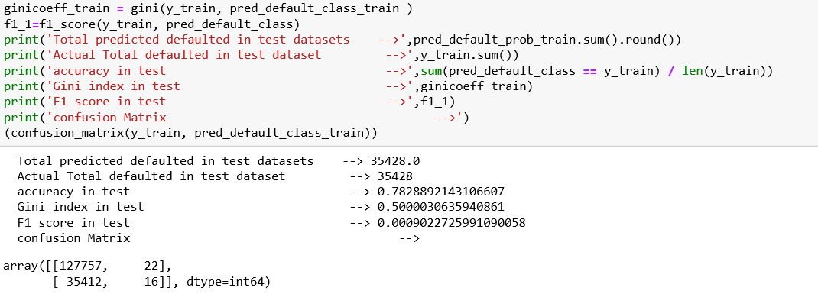
Appendix B : Analysis & Modelling –Discrimination power on Train data
Note : The python code for every model is tabulated

Slide 45
Thank you

